Slide 1
Shangsong Liang
SYSU
Convolutional Neural Networks
Lecture 7 -
Notes:
Produced by Fei-Fei Li & Andrej Karpathy & Justin Johnson

Slide 2
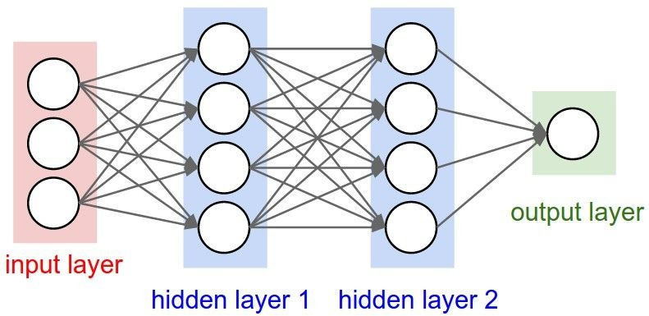
Mini-batch SGD
Loop:
Sample a batch of data
Forward prop it through the graph, get loss
Backprop to calculate the gradients
Update the parameters using the gradient

Slide 3
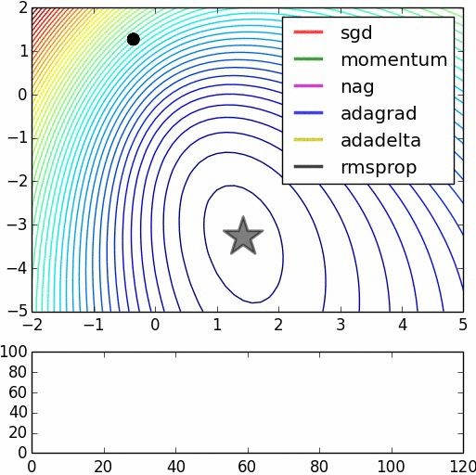
Parameter updates
We covered: sgd, momentum, nag, adagrad, rmsprop,
adam (not in this vis),
we did not cover adadelta
Image credits: Alec Radford

Slide 4
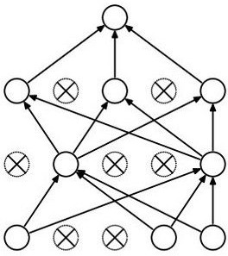
Dropout
Forces the network to have a redundant representation.
has an ear
has a tail is furry has claws
mischievous look
X
X
cat score
X

Slide 5
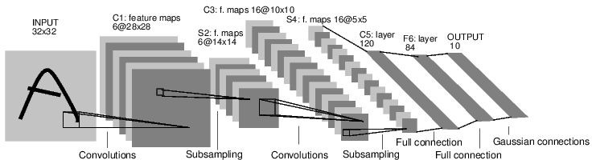
Convolutional Neural Networks
[LeNet-5, LeCun 1980]

Slide 6
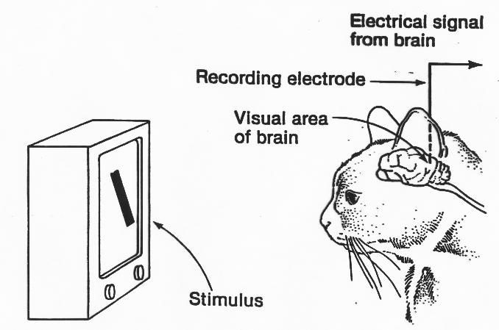
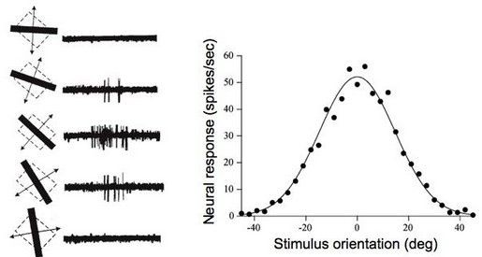
A bit of history:
Hubel & Wiesel, 1959
RECEPTIVE FIELDS OF SINGLE NEURONES IN
THE CAT'S STRIATE CORTEX
1962
RECEPTIVE FIELDS, BINOCULAR INTERACTION
AND FUNCTIONAL ARCHITECTURE IN THE CAT'S VISUAL CORTEX
1968...

Slide 7
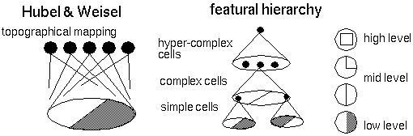
Hierarchical organization

Slide 8
Convolutional Neural Networks
(First without the brain stuff)

Slide 9
Convolution Layer
32x32x3 image
32
height
32
depth
width
3

Slide 10
Convolution Layer
32x32x3 image
5x5x3 filter
32
Convolve the filter with the image
i.e. “slide over the image spatially, computing dot products”
32
3

Slide 11
Convolution Layer
Filters always extend the full depth of the input volume
32x32x3 image
5x5x3 filter
32
Convolve the filter with the image
i.e. “slide over the image spatially, computing dot products”
32
3

Slide 12


Convolution Layer
32x32x3 image 5x5x3 filter
32
1 number:
the result of taking a dot product between the filter and a small 5x5x3 chunk of the image (i.e. 5*5*3 = 75-dimensional dot product + bias)
32
3

Slide 13
Convolution Layer
activation map
32x32x3 image 5x5x3 filter
32
28
convolve (slide) over all spatial locations
32
28
3
1

Slide 14
consider a second, green filter
Convolution Layer
32x32x3 image 5x5x3 filter
activation maps
32
28
convolve (slide) over all spatial locations
32
28
3
1

Slide 15
For example, if we had 6 5x5 filters, we’ll get 6 separate activation maps:
activation maps
32
28
Convolution Layer
32
28
3
6
We stack these up to get a “new image” of size 28x28x6!

Slide 16
Preview: ConvNet is a sequence of Convolution Layers, interspersed with activation functions
32
28
CONV, ReLU
e.g. 6 5x5x3 filters
32
28
3
6

Slide 17
Preview: ConvNet is a sequence of Convolutional Layers, interspersed with activation functions
32
28
24
….
CONV, ReLU
e.g. 6 5x5x3 filters
CONV, ReLU
e.g. 10 5x5x6 filters
CONV, ReLU
32
28
24
3
6
10

Slide 18
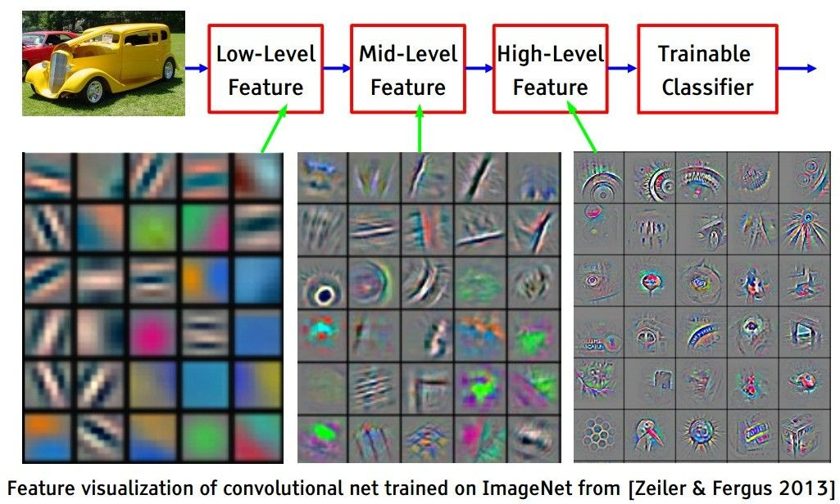
[From recent Yann LeCun slides]
Preview

Slide 19
[From recent Yann LeCun slides]
Preview

Slide 20
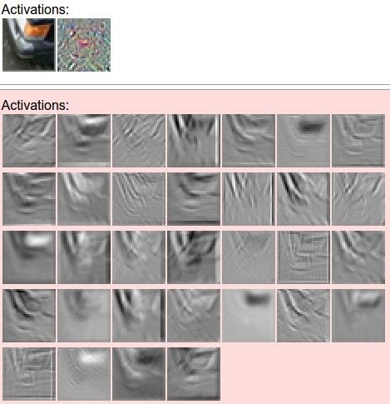

one filter =>
one activation map
example 5x5 filters
(32 total)
We call the layer convolutional because it is related to convolution of two signals:
elementwise multiplication and sum of a filter and the signal (image)

Slide 21
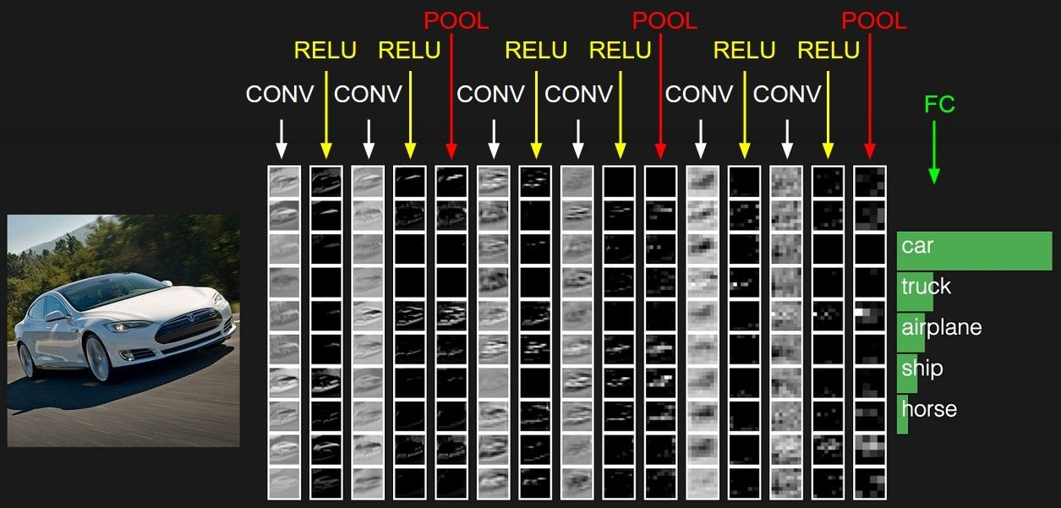
preview:

Slide 22
A closer look at spatial dimensions:
activation map
32x32x3 image 5x5x3 filter
32
28
convolve (slide) over all spatial locations
32
28
3
1

Slide 23
A closer look at spatial dimensions:
7
7x7 input (spatially) assume 3x3 filter
7

Slide 24
A closer look at spatial dimensions:
7
7x7 input (spatially) assume 3x3 filter
7

Slide 25
A closer look at spatial dimensions:
7
7x7 input (spatially) assume 3x3 filter
7

Slide 26
A closer look at spatial dimensions:
7
7x7 input (spatially) assume 3x3 filter
7

Slide 27
A closer look at spatial dimensions:
7
7x7 input (spatially) assume 3x3 filter
=> 5x5 output
7

Slide 28
A closer look at spatial dimensions:
7
7x7 input (spatially) assume 3x3 filter applied with stride 2
7

Slide 29
A closer look at spatial dimensions:
7
7x7 input (spatially) assume 3x3 filter applied with stride 2
7

Slide 30
A closer look at spatial dimensions:
7
7x7 input (spatially) assume 3x3 filter applied with stride 2
=> 3x3 output!
7

Slide 31
A closer look at spatial dimensions:
7
7x7 input (spatially) assume 3x3 filter applied with stride 3?
7

Slide 32
A closer look at spatial dimensions:
7
7x7 input (spatially) assume 3x3 filter applied with stride 3?
7
doesn’t fit!
cannot apply 3x3 filter on 7x7 input with stride 3.

Slide 33
N
Output size:
(N - F) / stride + 1
 |  |  | F
 | F
e.g. N = 7, F = 3:
stride 1 => (7 - 3)/1 + 1 = 5
stride 2 => (7 - 3)/2 + 1 = 3
stride 3 => (7 - 3)/3 + 1 = 2.33 :\
N

Slide 34
In practice: Common to zero pad the border
0 | 0 | 0 | 0 | 0 | 0
0
0
0
0
e.g. input 7x7
3x3 filter, applied with stride 1
pad with 1 pixel border => what is the output?
(recall:)
(N - F) / stride + 1

Slide 35
In practice: Common to zero pad the border
0 | 0 | 0 | 0 | 0 | 0
0
0
0
0
e.g. input 7x7
3x3 filter, applied with stride 1
pad with 1 pixel border => what is the output?
7x7 output!

Slide 36
In practice: Common to zero pad the border
0 | 0 | 0 | 0 | 0 | 0
0
0
0
0
e.g. input 7x7
3x3 filter, applied with stride 1
pad with 1 pixel border => what is the output?
7x7 output!
in general, common to see CONV layers with stride 1, filters of size FxF, and zero-padding with (F-1)/2. (will preserve size spatially)
e.g. F = 3 => zero pad with 1 F = 5 => zero pad with 2 F = 7 => zero pad with 3

Slide 37
Remember back to…
E.g. 32x32 input convolved repeatedly with 5x5 filters shrinks volumes spatially! (32 -> 28 -> 24 ...). Shrinking too fast is not good, doesn’t work well.
32
28
24
….
CONV, ReLU
e.g. 6 5x5x3 filters
CONV, ReLU
e.g. 10 5x5x6 filters
CONV, ReLU
32
28
24
3
6
10

Slide 38
Examples time:
Input volume: 32x32x3
10 5x5 filters with stride 1, pad 2
Output volume size: ?

Slide 39
Examples time:
Input volume: 32x32x3
10 5x5 filters with stride 1, pad 2
Output volume size:
(32+2*2-5)/1+1 = 32 spatially, so
32x32x10

Slide 40
Examples time:
Input volume: 32x32x3
10 5x5 filters with stride 1, pad 2
Number of parameters in this layer?

Slide 41
Examples time:
Input volume: 32x32x3
10 5x5 filters with stride 1, pad 2
Number of parameters in this layer? each filter has 5*5*3 + 1 = 76 params
=> 76*10 = 760
(+1 for bias)

Slide 42
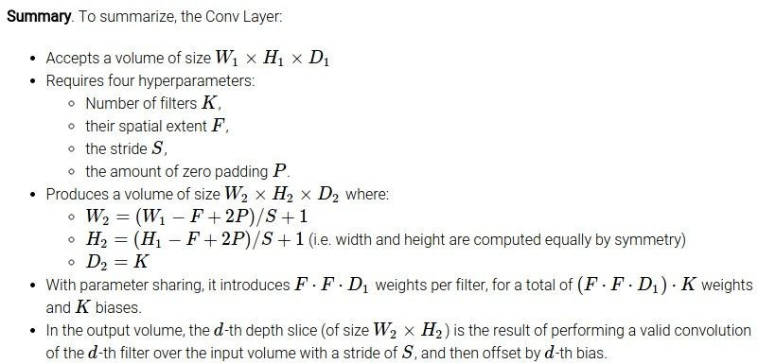

Slide 43
Common settings:
K = (powers of 2, e.g. 32, 64, 128, 512)
- F = 3, S = 1, P = 1
- F = 5, S = 1, P = 2
- F = 5, S = 2, P = ? (whatever fits)
- F = 1, S = 1, P = 0

Slide 44
(btw, 1x1 convolution layers make perfect sense)
1x1 CONV
with 32 filters
56
56
(each filter has size 1x1x64, and performs a 64-dimensional dot product)
56
56
64
32

Slide 45
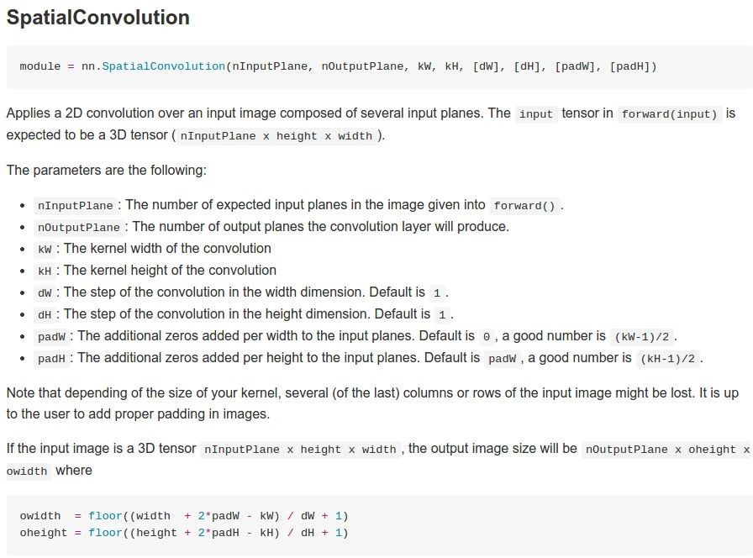
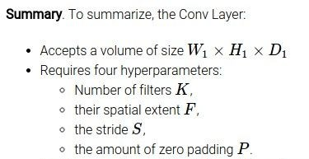
Example: CONV layer in Torch

Slide 46
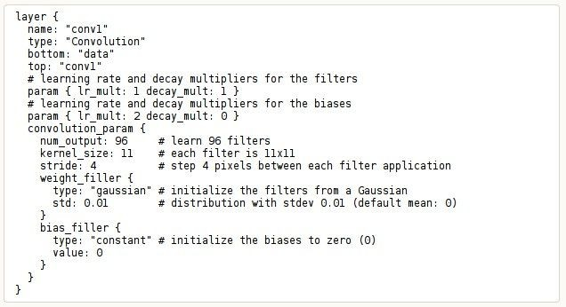
Example: CONV layer in Caffe

Slide 47
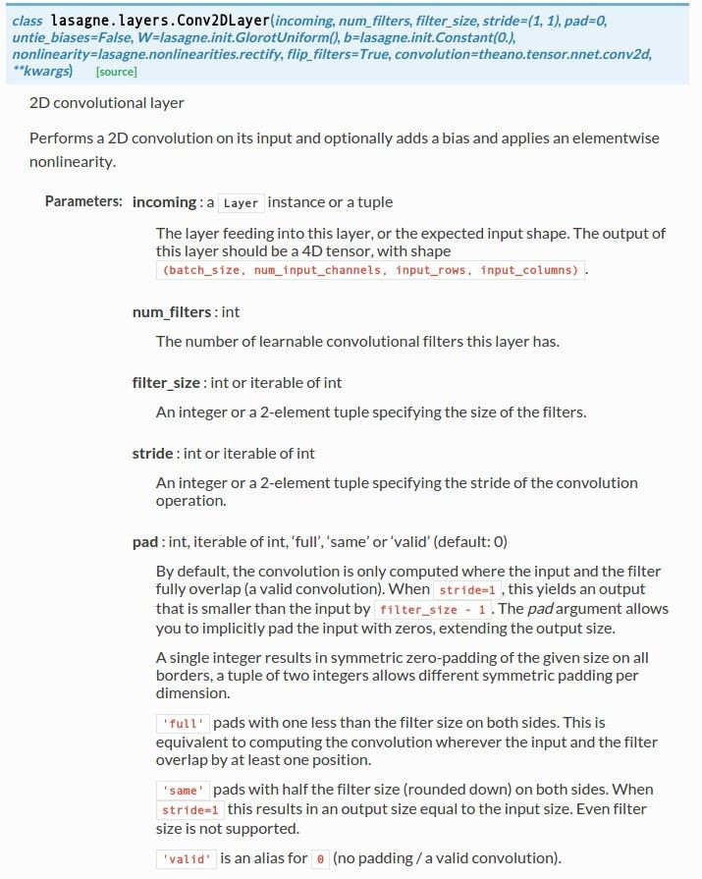
Example: CONV layer in Lasagne

Slide 48
The brain/neuron view of CONV Layer
32x32x3 image 5x5x3 filter
32
1 number:
the result of taking a dot product between the filter and this part of the image
(i.e. 5*5*3 = 75-dimensional dot product)
32
3

Slide 49
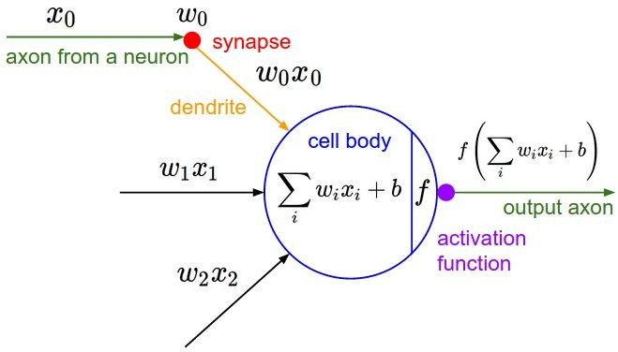
The brain/neuron view of CONV Layer
32x32x3 image 5x5x3 filter
32
It’s just a neuron with local connectivity...
1 number:
the result of taking a dot product between the filter and this part of the image
(i.e. 5*5*3 = 75-dimensional dot product)
32
3

Slide 50
The brain/neuron view of CONV Layer
32
28
An activation map is a 28x28 sheet of neuron outputs:
Each is connected to a small region in the input
All of them share parameters
32
28
“5x5 filter” -> “5x5 receptive field for each neuron”
3

Slide 51
The brain/neuron view of CONV Layer
32
E.g. with 5 filters,
CONV layer consists of neurons arranged in a 3D grid (28x28x5)
28
There will be 5 different neurons all looking at the same region in the input volume
32
28
3
5

Slide 52
two more layers to go: POOL/FC

Slide 53
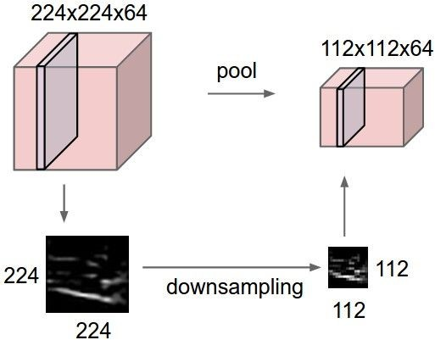
Pooling layer
makes the representations smaller and more manageable
operates over each activation map independently:

Slide 54
MAX POOLING
Single depth slice
1 | 1 | 2 | 4
5 | 6 | 7 | 8
3 | 2 | 1 | 0
1 | 2 | 3 | 4
x
max pool with 2x2 filters and stride 2
6 | 8
3 | 4
y

Slide 55
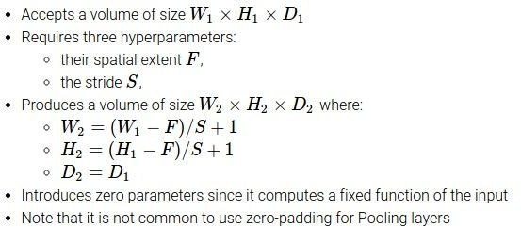

Slide 56
Common settings:
F = 2, S = 2
F = 3, S = 2

Slide 57
Fully Connected Layer (FC layer)
- Contains neurons that connect to the entire input volume, as in ordinary Neural Networks

Slide 58
[ConvNetJS demo: training on CIFAR-10]
http://cs.stanford.edu/people/karpathy/convnetjs/demo/cifar10.html

Slide 59
Case Study: LeNet-5
[LeCun et al., 1998]
Conv filters were 5x5, applied at stride 1
Subsampling (Pooling) layers were 2x2 applied at stride 2
i.e. architecture is [CONV-POOL-CONV-POOL-CONV-FC]

Slide 60
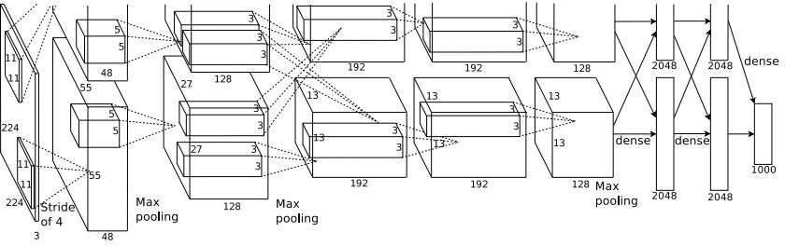
Case Study: AlexNet
[Krizhevsky et al. 2012]
Input: 227x227x3 images
First layer (CONV1): 96 11x11 filters applied at stride 4
=>
Q: what is the output volume size? Hint: (227-11)/4+1 = 55

Slide 61
Case Study: AlexNet
[Krizhevsky et al. 2012]
Input: 227x227x3 images
First layer (CONV1): 96 11x11 filters applied at stride 4
=>
Output volume [55x55x96]
Q: What is the total number of parameters in this layer?

Slide 62
Case Study: AlexNet
[Krizhevsky et al. 2012]
Input: 227x227x3 images
First layer (CONV1): 96 11x11 filters applied at stride 4
=>
Output volume [55x55x96]
Parameters: (11*11*3)*96 = 35K

Slide 63
Case Study: AlexNet
[Krizhevsky et al. 2012]
Input: 227x227x3 images After CONV1: 55x55x96
Second layer (POOL1): 3x3 filters applied at stride 2 Q: what is the output volume size? Hint: (55-3)/2+1 = 27

Slide 64
Case Study: AlexNet
[Krizhevsky et al. 2012]
Input: 227x227x3 images After CONV1: 55x55x96
Second layer (POOL1): 3x3 filters applied at stride 2 Output volume: 27x27x96
Q: what is the number of parameters in this layer?

Slide 65
Case Study: AlexNet
[Krizhevsky et al. 2012]
Input: 227x227x3 images After CONV1: 55x55x96
Second layer (POOL1): 3x3 filters applied at stride 2 Output volume: 27x27x96
Parameters: 0!

Slide 66
Case Study: AlexNet
[Krizhevsky et al. 2012]
Input: 227x227x3 images After CONV1: 55x55x96 After POOL1: 27x27x96
...

Slide 67
Case Study: AlexNet
[Krizhevsky et al. 2012]
Full (simplified) AlexNet architecture: [227x227x3] INPUT
[55x55x96] CONV1: 96 11x11 filters at stride 4, pad 0 [27x27x96] MAX POOL1: 3x3 filters at stride 2 [27x27x96] NORM1: Normalization layer
[27x27x256] CONV2: 256 5x5 filters at stride 1, pad 2 [13x13x256] MAX POOL2: 3x3 filters at stride 2 [13x13x256] NORM2: Normalization layer [13x13x384] CONV3: 384 3x3 filters at stride 1, pad 1 [13x13x384] CONV4: 384 3x3 filters at stride 1, pad 1 [13x13x256] CONV5: 256 3x3 filters at stride 1, pad 1 [6x6x256] MAX POOL3: 3x3 filters at stride 2
[4096] FC6: 4096 neurons
[4096] FC7: 4096 neurons
[1000] FC8: 1000 neurons (class scores)

Slide 68
Case Study: AlexNet
[Krizhevsky et al. 2012]
Full (simplified) AlexNet architecture: [227x227x3] INPUT
[55x55x96] CONV1: 96 11x11 filters at stride 4, pad 0 [27x27x96] MAX POOL1: 3x3 filters at stride 2 [27x27x96] NORM1: Normalization layer
[27x27x256] CONV2: 256 5x5 filters at stride 1, pad 2 [13x13x256] MAX POOL2: 3x3 filters at stride 2 [13x13x256] NORM2: Normalization layer [13x13x384] CONV3: 384 3x3 filters at stride 1, pad 1 [13x13x384] CONV4: 384 3x3 filters at stride 1, pad 1 [13x13x256] CONV5: 256 3x3 filters at stride 1, pad 1 [6x6x256] MAX POOL3: 3x3 filters at stride 2
Details/Retrospectives:
first use of ReLU
used Norm layers (not common anymore)
heavy data augmentation
dropout 0.5
batch size 128
SGD Momentum 0.9
Learning rate 1e-2, reduced by 10 manually when val accuracy plateaus
L2 weight decay 5e-4
[4096] FC6: 4096 neurons
[4096] FC7: 4096 neurons
[1000] FC8: 1000 neurons (class scores)
- 7 CNN ensemble: 18.2% -> 15.4%

Slide 69
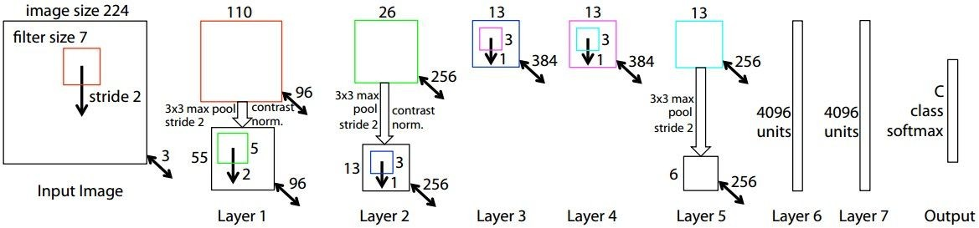
Case Study: ZFNet
[Zeiler and Fergus, 2013]
AlexNet but:
CONV1: change from (11x11 stride 4) to (7x7 stride 2) CONV3,4,5: instead of 384, 384, 256 filters use 512, 1024, 512
ImageNet top 5 error: 15.4% -> 14.8%

Slide 70
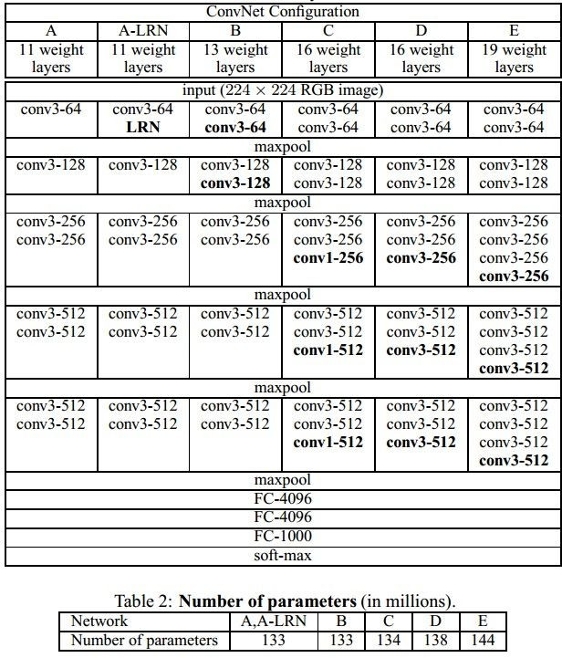
Case Study: VGGNet
[Simonyan and Zisserman, 2014]
Only 3x3 CONV stride 1, pad 1 and 2x2 MAX POOL stride 2
best model
11.2% top 5 error in ILSVRC 2013
->
7.3% top 5 error

Slide 71
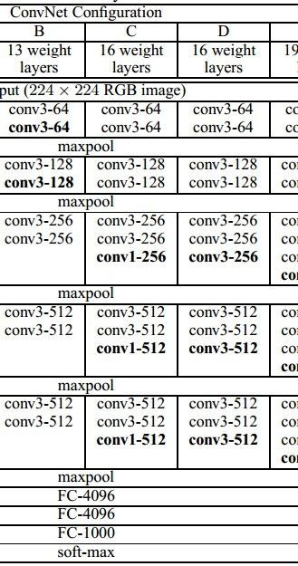
(not counting biases)
INPUT: [224x224x3] memory: 224*224*3=150K params: 0
CONV3-64: [224x224x64] memory: 224*224*64=3.2M params: (3*3*3)*64 = 1,728 CONV3-64: [224x224x64] memory: 224*224*64=3.2M params: (3*3*64)*64 = 36,864
POOL2: [112x112x64] memory: 112*112*64=800K params: 0
CONV3-128: [112x112x128] memory: 112*112*128=1.6M params: (3*3*64)*128 = 73,728 CONV3-128: [112x112x128] memory: 112*112*128=1.6M params: (3*3*128)*128 = 147,456
POOL2: [56x56x128] memory: 56*56*128=400K params: 0
CONV3-256: [56x56x256] memory: 56*56*256=800K params: (3*3*128)*256 = 294,912 CONV3-256: [56x56x256] memory: 56*56*256=800K params: (3*3*256)*256 = 589,824 CONV3-256: [56x56x256] memory: 56*56*256=800K params: (3*3*256)*256 = 589,824
POOL2: [28x28x256] memory: 28*28*256=200K params: 0
CONV3-512: [28x28x512] memory: 28*28*512=400K params: (3*3*256)*512 = 1,179,648 CONV3-512: [28x28x512] memory: 28*28*512=400K params: (3*3*512)*512 = 2,359,296 CONV3-512: [28x28x512] memory: 28*28*512=400K params: (3*3*512)*512 = 2,359,296
POOL2: [14x14x512] memory: 14*14*512=100K params: 0
CONV3-512: [14x14x512] memory: 14*14*512=100K params: (3*3*512)*512 = 2,359,296 CONV3-512: [14x14x512] memory: 14*14*512=100K params: (3*3*512)*512 = 2,359,296 CONV3-512: [14x14x512] memory: 14*14*512=100K params: (3*3*512)*512 = 2,359,296
POOL2: [7x7x512] memory: 7*7*512=25K params: 0
FC: [1x1x4096] memory: 4096 params: 7*7*512*4096 = 102,760,448 FC: [1x1x4096] memory: 4096 params: 4096*4096 = 16,777,216
FC: [1x1x1000] memory: 1000 params: 4096*1000 = 4,096,000

Slide 72
(not counting biases)
INPUT: [224x224x3] memory: 224*224*3=150K params: 0
CONV3-64: [224x224x64] memory: 224*224*64=3.2M params: (3*3*3)*64 = 1,728 CONV3-64: [224x224x64] memory: 224*224*64=3.2M params: (3*3*64)*64 = 36,864
POOL2: [112x112x64] memory: 112*112*64=800K params: 0
CONV3-128: [112x112x128] memory: 112*112*128=1.6M params: (3*3*64)*128 = 73,728 CONV3-128: [112x112x128] memory: 112*112*128=1.6M params: (3*3*128)*128 = 147,456
POOL2: [56x56x128] memory: 56*56*128=400K params: 0
CONV3-256: [56x56x256] memory: 56*56*256=800K params: (3*3*128)*256 = 294,912 CONV3-256: [56x56x256] memory: 56*56*256=800K params: (3*3*256)*256 = 589,824 CONV3-256: [56x56x256] memory: 56*56*256=800K params: (3*3*256)*256 = 589,824
POOL2: [28x28x256] memory: 28*28*256=200K params: 0
CONV3-512: [28x28x512] memory: 28*28*512=400K params: (3*3*256)*512 = 1,179,648 CONV3-512: [28x28x512] memory: 28*28*512=400K params: (3*3*512)*512 = 2,359,296 CONV3-512: [28x28x512] memory: 28*28*512=400K params: (3*3*512)*512 = 2,359,296
POOL2: [14x14x512] memory: 14*14*512=100K params: 0
CONV3-512: [14x14x512] memory: 14*14*512=100K params: (3*3*512)*512 = 2,359,296 CONV3-512: [14x14x512] memory: 14*14*512=100K params: (3*3*512)*512 = 2,359,296 CONV3-512: [14x14x512] memory: 14*14*512=100K params: (3*3*512)*512 = 2,359,296
POOL2: [7x7x512] memory: 7*7*512=25K params: 0
FC: [1x1x4096] memory: 4096 params: 7*7*512*4096 = 102,760,448 FC: [1x1x4096] memory: 4096 params: 4096*4096 = 16,777,216
FC: [1x1x1000] memory: 1000 params: 4096*1000 = 4,096,000
TOTAL memory: 24M * 4 bytes ~= 93MB / image (only forward! ~*2 for bwd) TOTAL params: 138M parameters

Slide 73
(not counting biases)
INPUT: [224x224x3] memory: 224*224*3=150K params: 0
CONV3-64: [224x224x64] memory: 224*224*64=3.2M params: (3*3*3)*64 = 1,728 CONV3-64: [224x224x64] memory: 224*224*64=3.2M params: (3*3*64)*64 = 36,864
POOL2: [112x112x64] memory: 112*112*64=800K params: 0
CONV3-128: [112x112x128] memory: 112*112*128=1.6M params: (3*3*64)*128 = 73,728 CONV3-128: [112x112x128] memory: 112*112*128=1.6M params: (3*3*128)*128 = 147,456
POOL2: [56x56x128] memory: 56*56*128=400K params: 0
CONV3-256: [56x56x256] memory: 56*56*256=800K params: (3*3*128)*256 = 294,912 CONV3-256: [56x56x256] memory: 56*56*256=800K params: (3*3*256)*256 = 589,824 CONV3-256: [56x56x256] memory: 56*56*256=800K params: (3*3*256)*256 = 589,824
POOL2: [28x28x256] memory: 28*28*256=200K params: 0
CONV3-512: [28x28x512] memory: 28*28*512=400K params: (3*3*256)*512 = 1,179,648 CONV3-512: [28x28x512] memory: 28*28*512=400K params: (3*3*512)*512 = 2,359,296 CONV3-512: [28x28x512] memory: 28*28*512=400K params: (3*3*512)*512 = 2,359,296
POOL2: [14x14x512] memory: 14*14*512=100K params: 0
CONV3-512: [14x14x512] memory: 14*14*512=100K params: (3*3*512)*512 = 2,359,296 CONV3-512: [14x14x512] memory: 14*14*512=100K params: (3*3*512)*512 = 2,359,296 CONV3-512: [14x14x512] memory: 14*14*512=100K params: (3*3*512)*512 = 2,359,296
POOL2: [7x7x512] memory: 7*7*512=25K params: 0
FC: [1x1x4096] memory: 4096 params: 7*7*512*4096 = 102,760,448
FC: [1x1x4096] memory: 4096 params: 4096*4096 = 16,777,216 FC: [1x1x1000] memory: 1000 params: 4096*1000 = 4,096,000
TOTAL memory: 24M * 4 bytes ~= 93MB / image (only forward! ~*2 for bwd) TOTAL params: 138M parameters
Note:
Most memory is in early CONV
Most params are in late FC

Slide 74
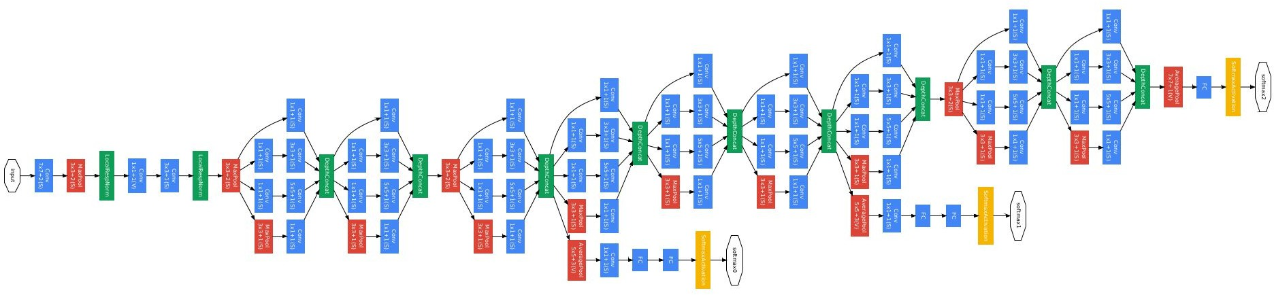
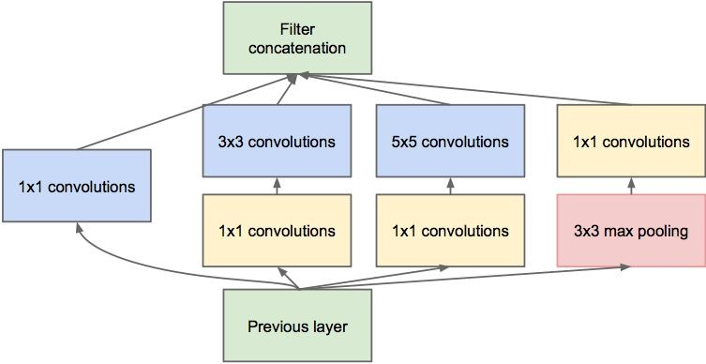
Case Study: GoogLeNet
[Szegedy et al., 2014]
Inception module
ILSVRC 2014 winner (6.7% top 5 error)

Slide 75
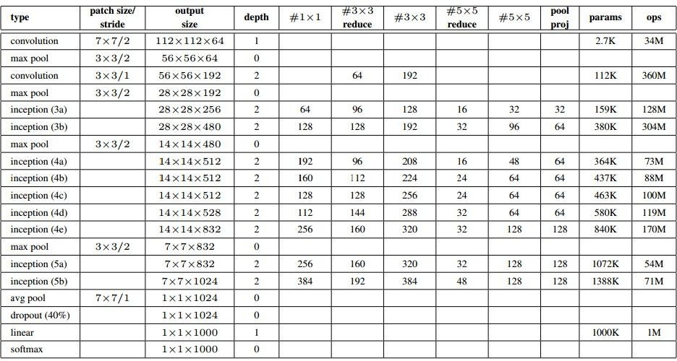
Case Study: GoogLeNet
Fun features:
Only 5 million params! (Removes FC layers completely)
Compared to AlexNet:
12X less params
2x more compute
- 6.67% (vs. 16.4%)

Slide 76
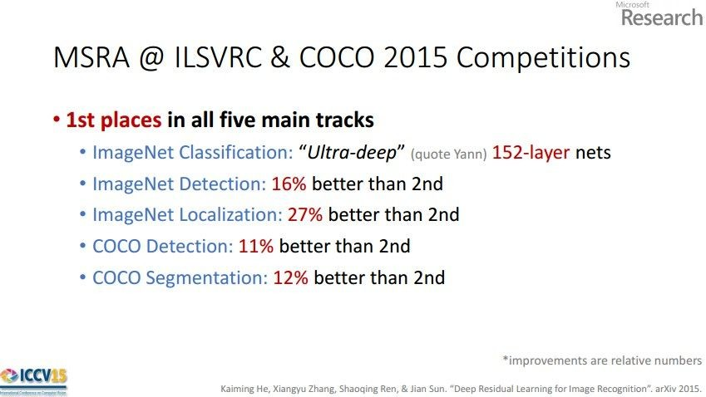
Case Study: ResNet
[He et al., 2015]
ILSVRC 2015 winner (3.6% top 5 error)
Slide from Kaiming He’s recent presentation https://www.youtube.com/watch?v=1PGLj-uKT1w

Slide 77
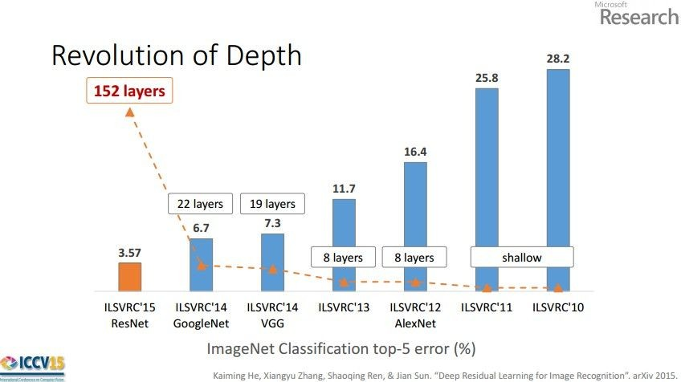
(slide from Kaiming He’s recent presentation)

Slide 78
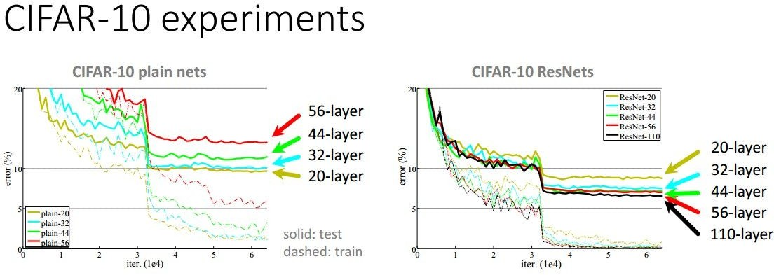

Slide 79
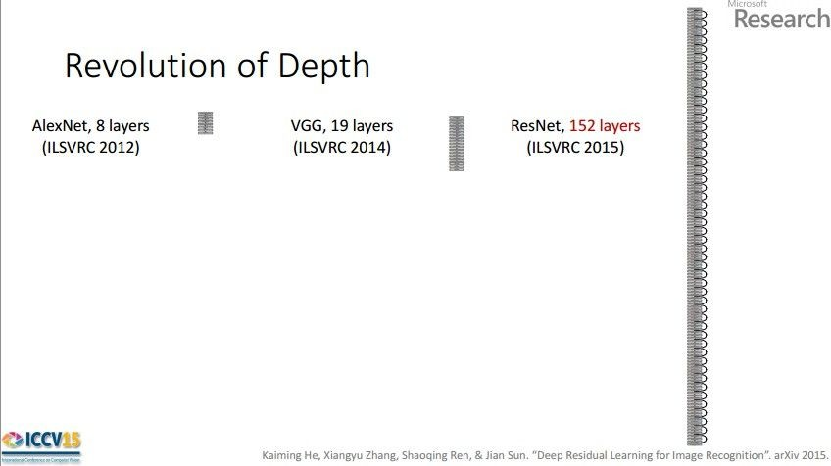
Case Study: ResNet
[He et al., 2015]
ILSVRC 2015 winner (3.6% top 5 error)
2-3 weeks of training on 8 GPU machine
at runtime: faster than a VGGNet! (even though it has 8x more layers)
(slide from Kaiming He’s recent presentation)

Slide 80
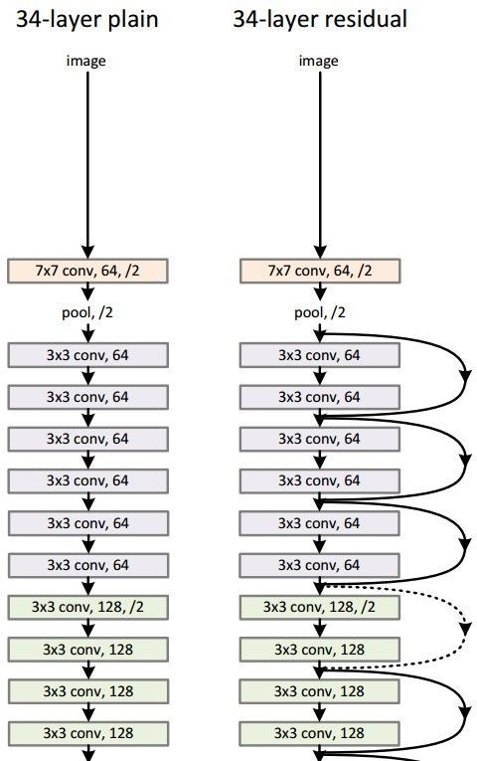
Case Study: ResNet
224x224x3
spatial dimension only 56x56!
[He et al., 2015]

Slide 81
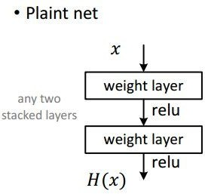
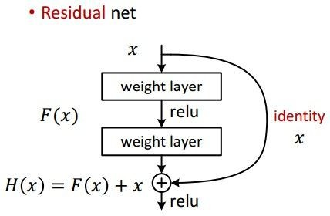
Case Study: ResNet
[He et al., 2015]

Slide 82
Case Study: ResNet
[He et al., 2015]
Batch Normalization after every CONV layer
Xavier/2 initialization from He et al.
SGD + Momentum (0.9)
Learning rate: 0.1, divided by 10 when validation error plateaus
Mini-batch size 256
Weight decay of 1e-5
No dropout used

Slide 83
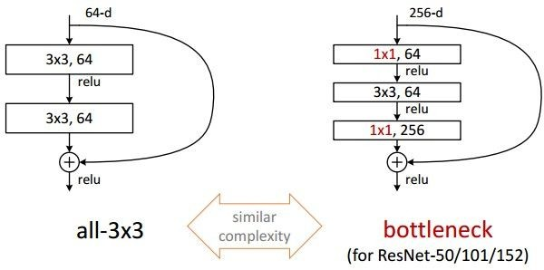
Case Study: ResNet
[He et al., 2015]

Slide 84
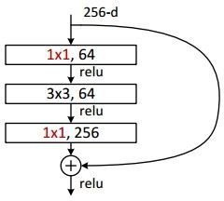
Case Study: ResNet
[He et al., 2015]
(this trick is also used in GoogLeNet)

Slide 85
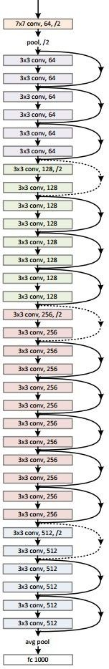
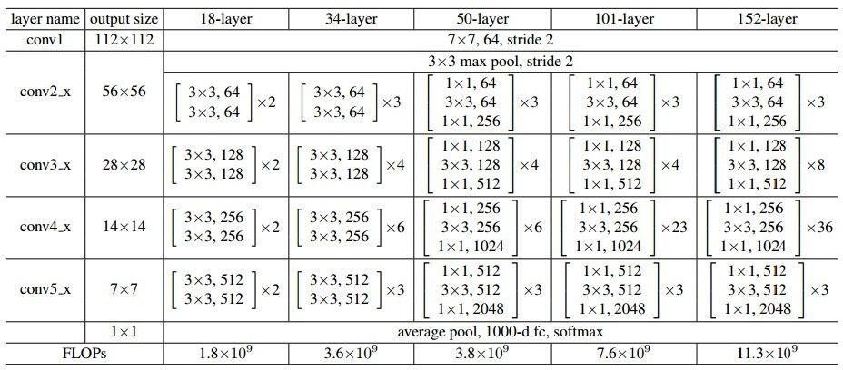
Case Study: ResNet
[He et al., 2015]

Slide 86
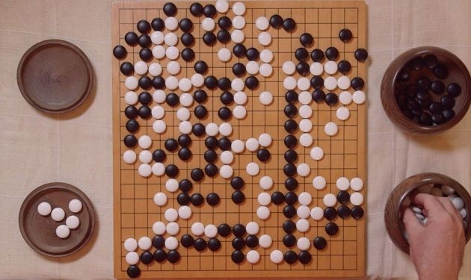
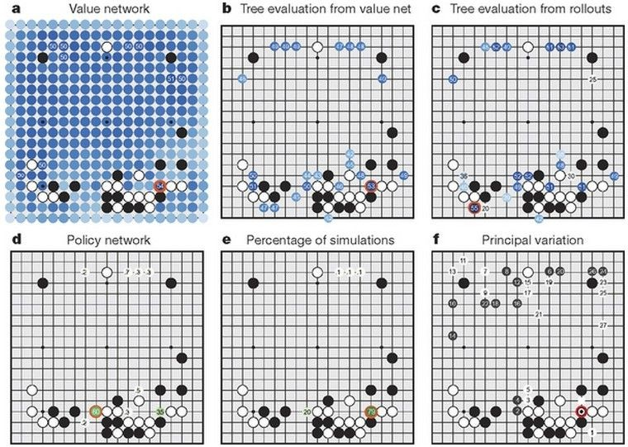

Case Study Bonus: DeepMind’s AlphaGo

Slide 87
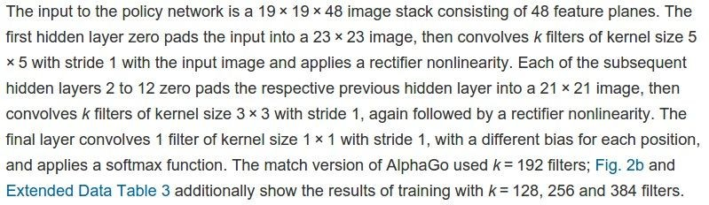
policy network:
[19x19x48] Input
CONV1: 192 5x5 filters , stride 1, pad 2 => [19x19x192] CONV2..12: 192 3x3 filters, stride 1, pad 1 => [19x19x192]
CONV: 1 1x1 filter, stride 1, pad 0 => [19x19] (probability map of promising moves)

Slide 88
Summary
ConvNets stack CONV,POOL,FC layers
Trend towards smaller filters and deeper architectures
Trend towards getting rid of POOL/FC layers (just CONV)
Typical architectures look like
[(CONV-RELU)*N-POOL?]*M-(FC-RELU)*K,SOFTMAX
where N is usually up to ~5, M is large, 0 <= K <= 2.
- but recent advances such as ResNet/GoogLeNet challenge this paradigm

